Slide 1
SCHOLARSHIP2ALL
Done by : K Amarnath
Kripakara M N
Manoj Howale S
Under guidance of - Madhavi R P
Associate Professor
1

Slide 2
Contents
Introduction
Software Requirement and specification
Relevance or importance of the project
User Interface Design
About us
Contact us
Future Enhancements
Conclusion
References

Slide 3
Introduction
Scholarships can provide financial assistance for those who can't afford higher studies but are talented and needy. College and university scholarships are a convenient way to pay for an undergraduate degree.
When it comes to searching for scholarships, you need to make sure you know where you can find them. Some of them are offered locally by high schools and community businesses, while colleges provide others.

Slide 4
Software Requirement and specification
A PC with the following or greater specifications:
Windows 8 or above
Intel Core i5 (6th gen or higher)
8 GB RAM
500 GB Hard Drive or SSD
Visual Studio Code / AtomGitHub repositories
HTML, CSS, JavaScript
Bootstrap
Fontawesome.com
Google fonts

Slide 5
Relevance of the Project
This website is designed by us to help students to find the best scholarship scheme suitable for them.
We provide easy access to scholarships with connections between seekers and scholarship providers.
Our vision is to ensure affordable education for all, mission is to simplify scholarship accessibility for students and disbursement process for providers.
Our scholarship allows both seekers and scholarship providers to access curated scholarship information.
5

Slide 6
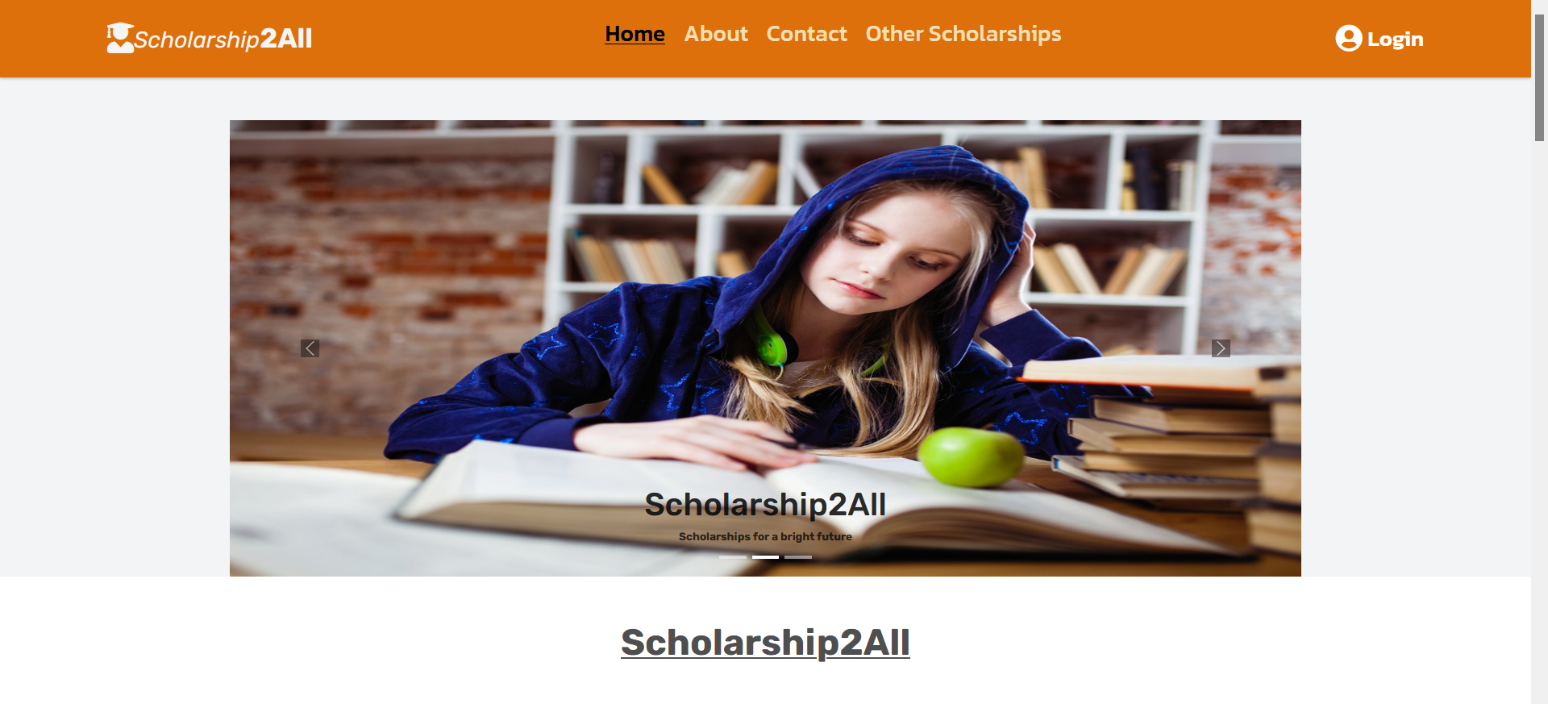
User Interface Design
The home page is designed for the user to know about our mission and more importantly for providing information about the varieties of scholarship.
6

Slide 7
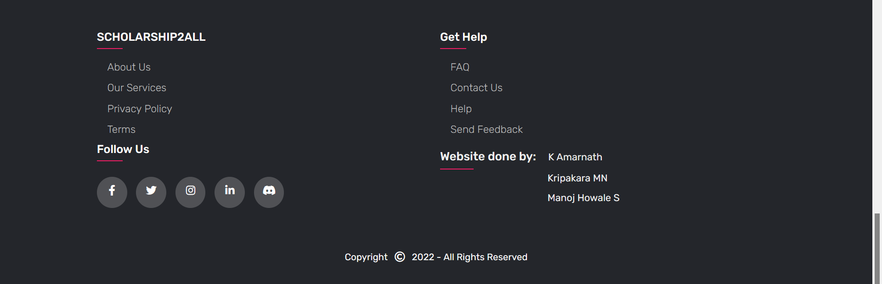
Footer
7

Slide 8
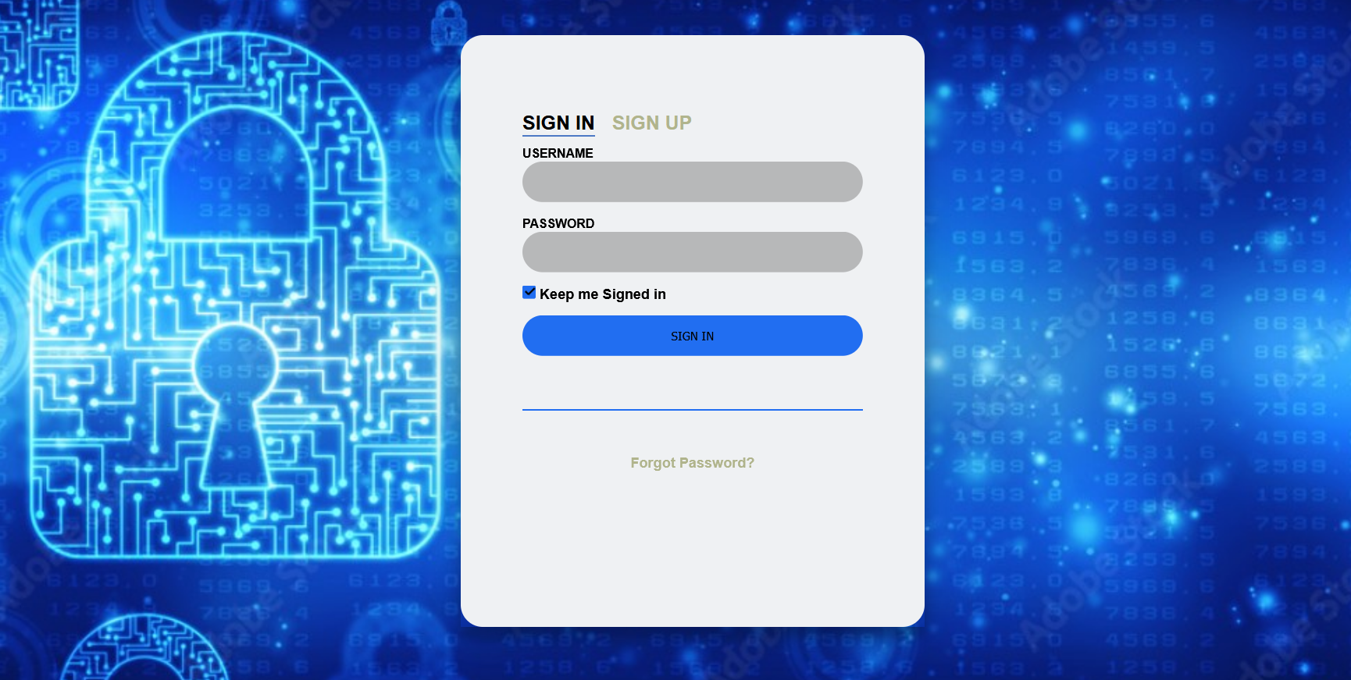
Sign-in page
The user has to first signup before signing in. Upon doing so they’ll be redirected to the registration form page.
8

Slide 9
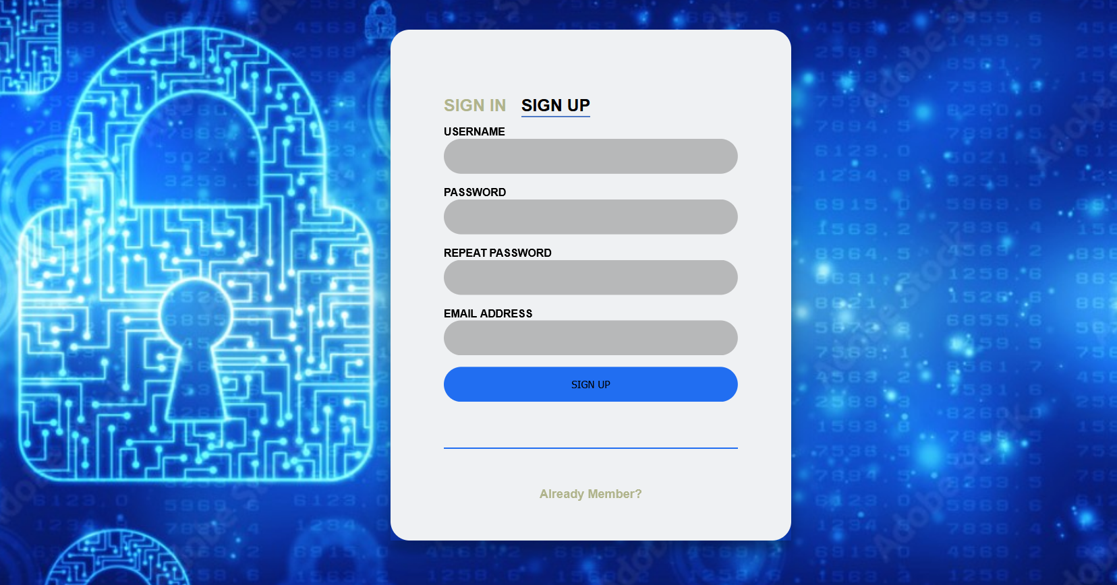
Sign-up page
The user will be provided with an option to signup if they don’t have an account. Upon doing so they’ll be redirected to the registration form page.
9

Slide 10
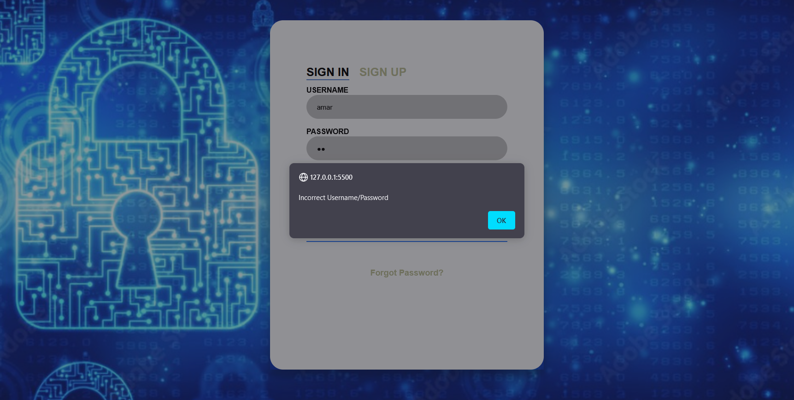
Sign-in page
If the entered credentials is wrong then the user gets a pop-up saying that the entered credentials is incorrect.
The user wont be logged in until the correct details is entered.
10

Slide 11
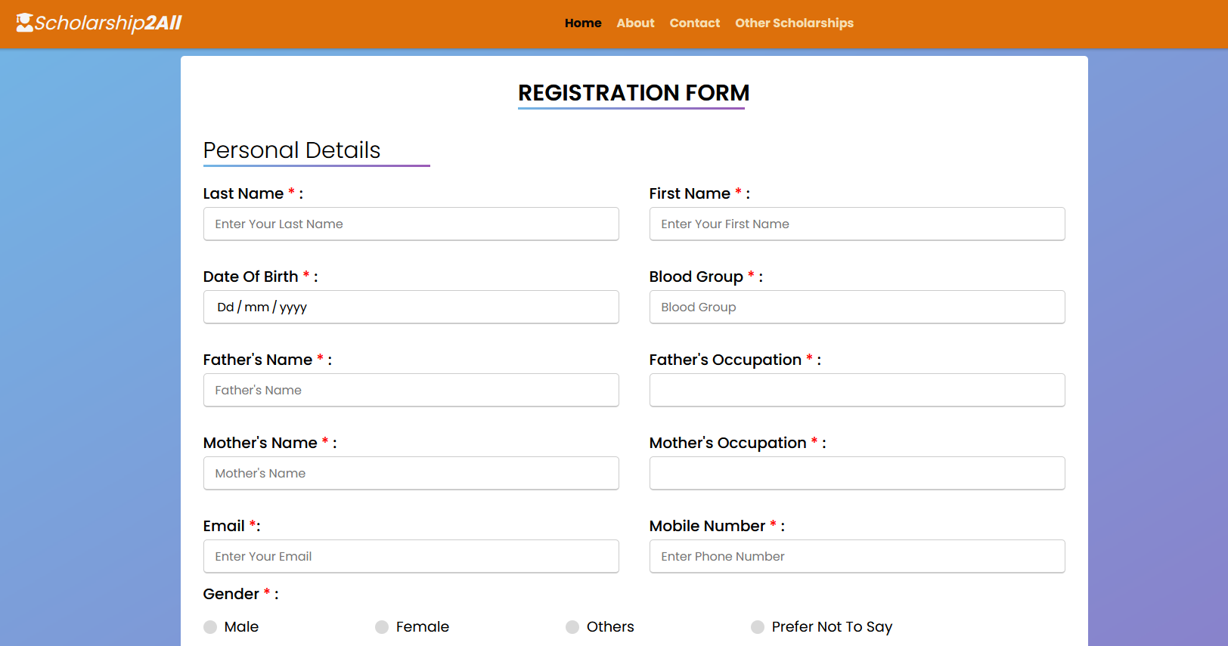
Registration form
11

Slide 12
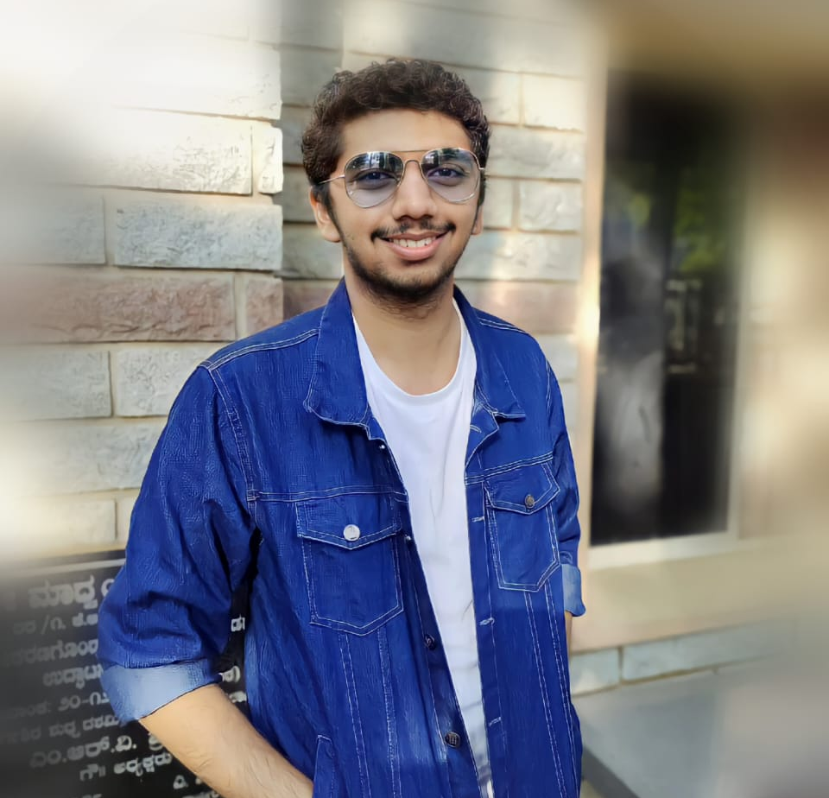
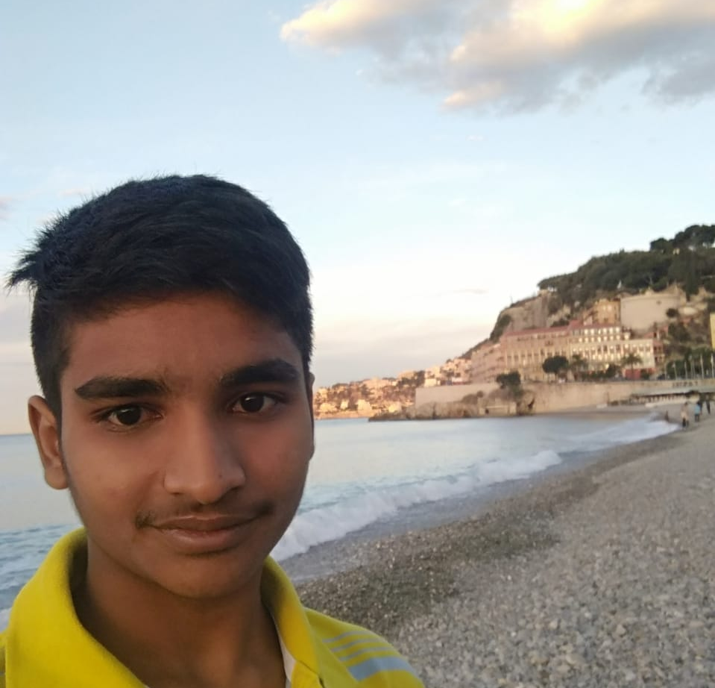
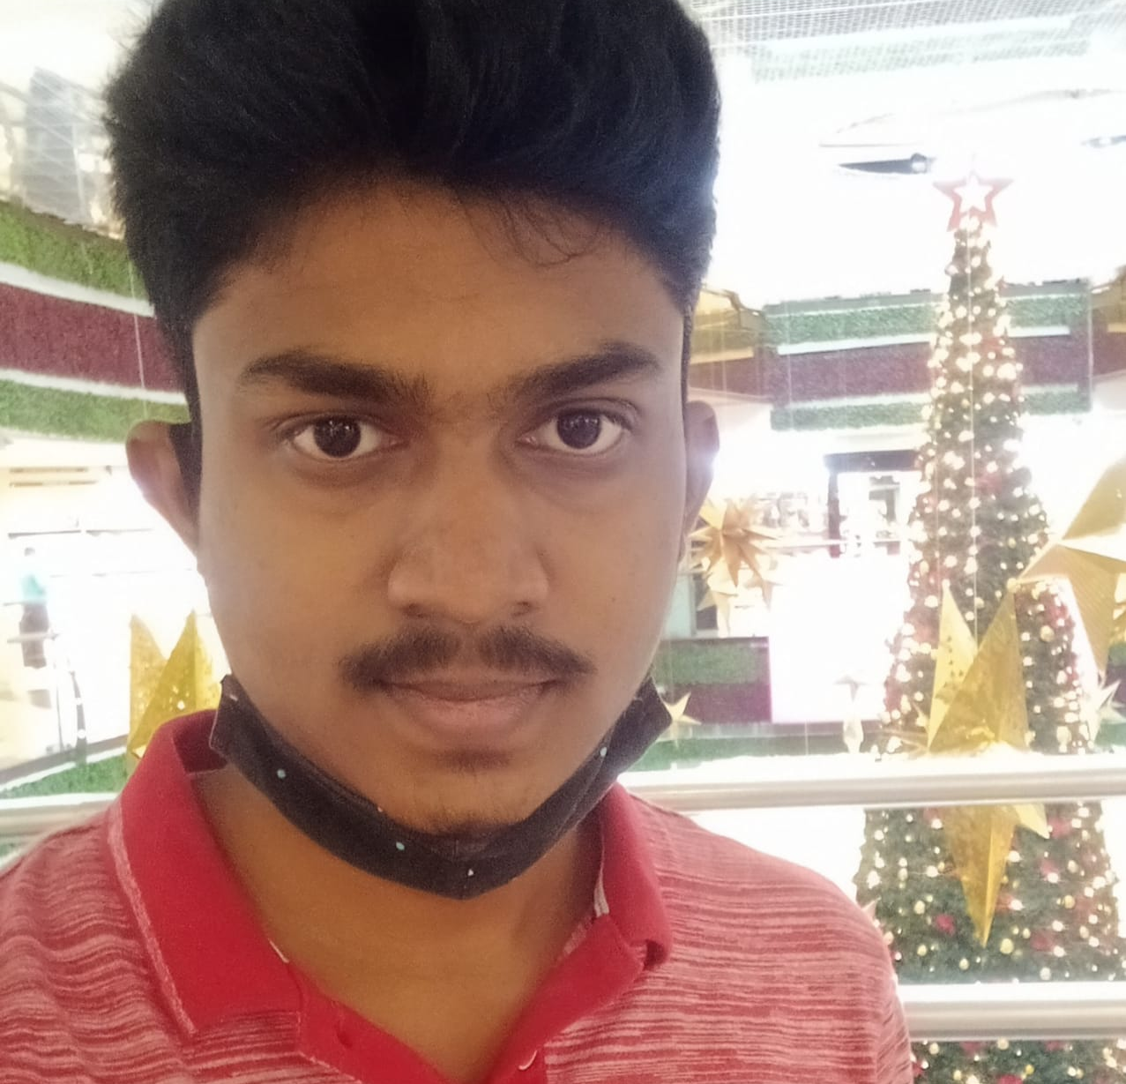
Our team
Kripakara M N
K Amarnath
Manoj Howale S
1BM20CS075
1BM20CS074
1BM20CS082
12

Slide 13
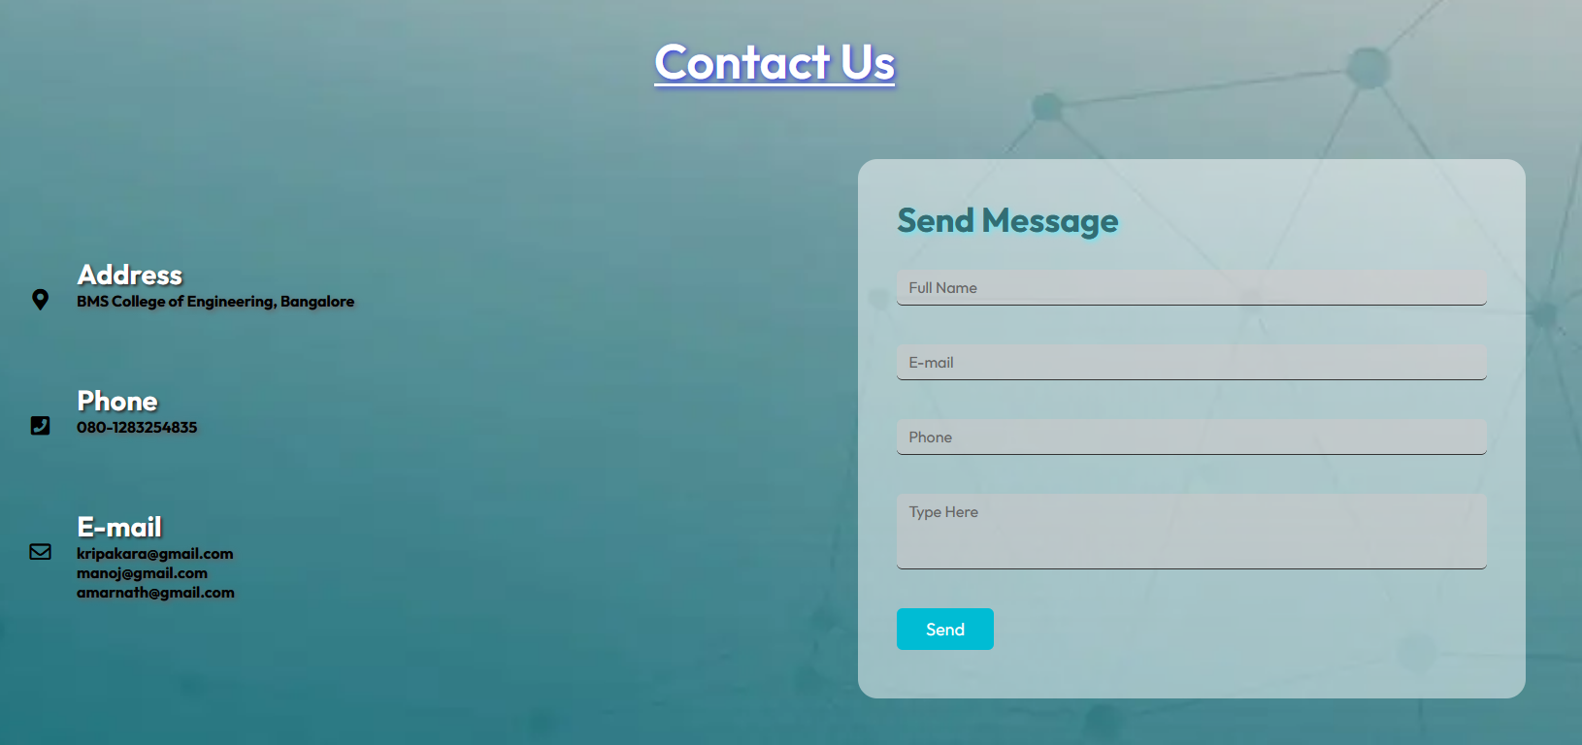
Contact page
The users can interact with us regarding any queries via this page.
13

Slide 14
Future Enhancement
Login using different social accounts such as Gmail, Facebook, LinkedIn, etc.
Backend interface will be designed using PHP so that all the users to store their data.
Providing a user interface to view and edit the account details which is provided in the registration form.
Increasing the website reach by adding more scholarships and providing various courses.
Providing a interface for scholarship providers to put their scholarships in our website.
Addition of search bar to find the required scholarship easily.

Slide 15
Conclusion
Working on this project helped us to understand how websites that we use every day are built from scratch.
Effective communication with each other while dividing the work amongst us was slowly but surely developed by working on our website.
Working on this project as a team helped us to enhance our coordinating and managing skills.
Gained a lot of knowledge and learnt various new topics (HTML & CSS).
Planning, goal setting, prioritizing are the principles which made this website possible.
15

Slide 16
References
Easy Tutorials (Channel for web development using Html, CSS and JavaScript)
Code IO introductory course
W3schools (HTML and CSS)
Bootstrap (Templates for reference and ideas)
Visual Studio Code (To realize basic elements of HTML)
16

Slide 17
Thank you
17

